Slide 1

Data Quality – Corporate Clients
How to make the most of bank data
19 July 2017

Slide 2
Agenda
Overview
Encountered issues
Potential opportunities
Notes:
So.. we’ll briefly explain the field of Data Science.
Why Data Science is particularly useful in the financial services industry.
And most importantly, we’ll focus on our progress here at OBSG thus far.

Slide 3
Overview (1/2)
As a second milestone of the data audit roadmap, defined in March ’17 and adjusted at Q2 OBSG 50,
we preformed an analysis the corporate demographic data.
1. Data points analyzed:
Legal status: DOOEL, DOO, Inc, etc;
Company size: Micro, Small, Medium, Large;
Market & industry: Trade, Taxi services, etc;
Age since foundation
Seniority with OBSG
Annual and Monthly average;
Dependent on clients age, location, size;
Outflow to competitors: OBSG’s corporate clients who are deponents at competitors
Number of : OBSG’s corporate clients who are deponents at competitors
2. Data points missing or need improvement:
Enterprises vs. Professionals separator: No indicator or clear method to split population;
No activity indicator: Currently determined through live accounts, a more precise definition needed;
Hard churn indicator: No indicator to determine hard churners;
Total number of employees per client: No data source;
Categorization of industries: Currently distribution is made through CRM data very granular;
Missing data points: A lot of data points are missing for important variables such as client entry date in the bank, company size, etc.

Slide 4
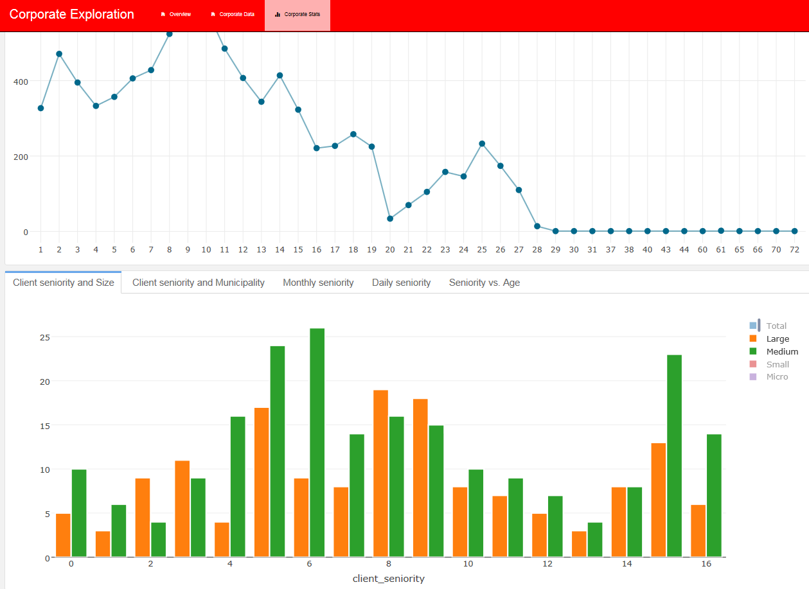
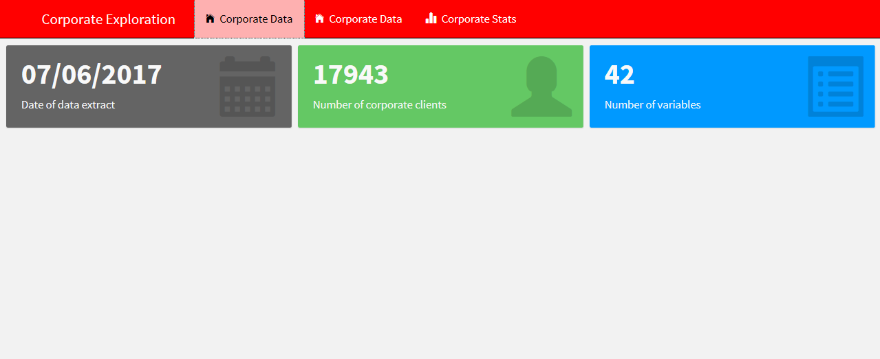
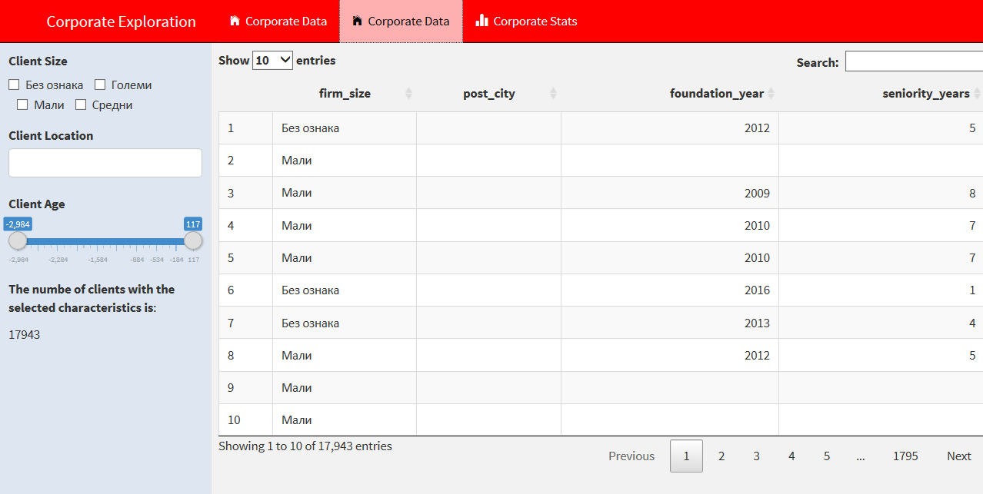
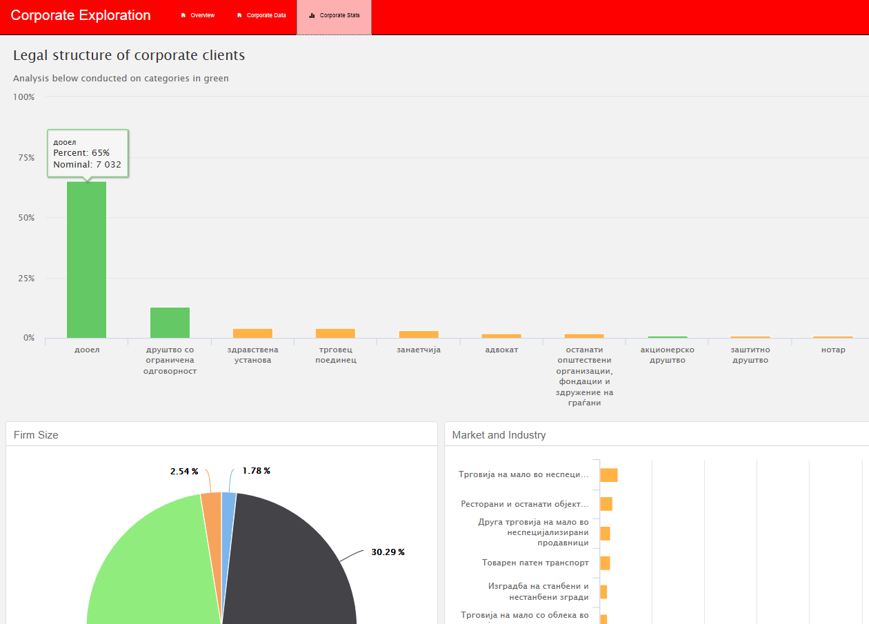
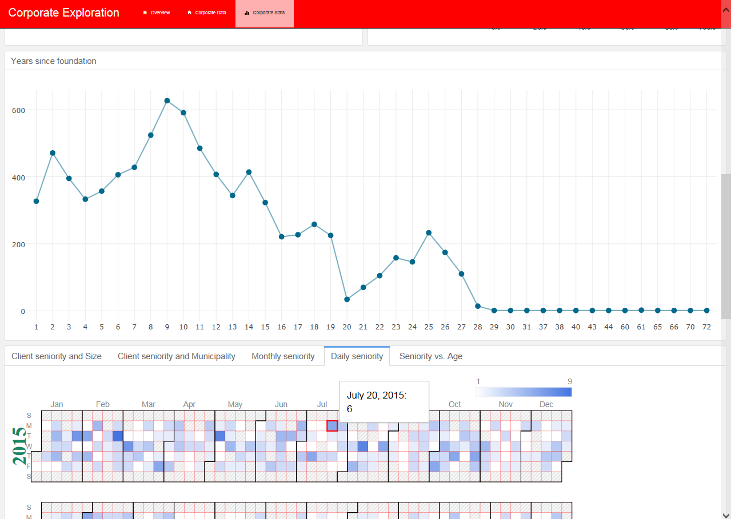
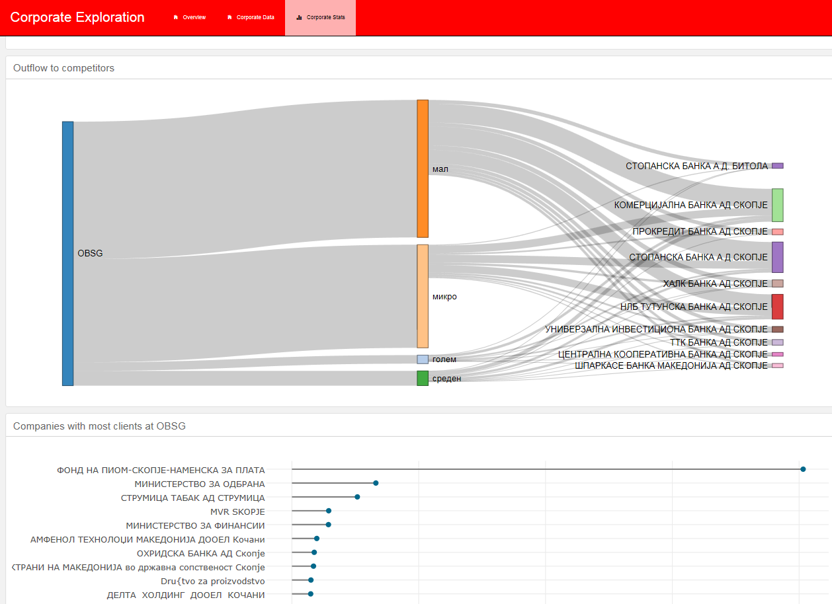
Overview (2/2)
3. Analysis output:
- Interactive corporate dashboard
- Local HTML file

Slide 5
Agenda
Overview
Encountered issues
Potential opportunities
Notes:
So.. we’ll briefly explain the field of Data Science.
Why Data Science is particularly useful in the financial services industry.
And most importantly, we’ll focus on our progress here at OBSG thus far.

Slide 6
Encountered issues
Internal data of relatively poor quality for demographic information:
We relied for multiple variables on external data sources, such as the Central Registry of Macedonia or the Public Tax Authority, as the internal database is missing a lot of data points.
Non existence of a Database diagram makes it difficult to understand the data and how the data is related in the database for multiple reasons:
Names of tables and variables are not descriptive: IMALC or RACUNIL have no meaning to anyone other than the Database Administrator;
There are duplicate tables with no clear description which one is relevant or not;
Not clear which tables contain description for indicators
Code sharing and version control needed with IT
Code sharing on a platform such as GitHub is a standard in team collaboration;
Code and SQL queries should be well documented and stored on GitHub, otherwise there is redundancy in the work.
Limited inactivity without access to a server
There is limited possibility to perform calculations and different filtering within the dashboard we’ve created without a server running in the background.

Slide 7
Agenda
Overview
Encountered issues
Potential opportunities
Notes:
So.. we’ll briefly explain the field of Data Science.
Why Data Science is particularly useful in the financial services industry.
And most importantly, we’ll focus on our progress here at OBSG thus far.

Slide 8
Opportunities
The technology stack we are using – R Studio and Microsoft SQL Studio – enables us to analyze data
and build data products extremely quickly, compared to more robust languages such as Java and C#
that are typically used in CRM or other reporting systems. For instance, we can:
Build new data products in days or weeks, and than;
Add new features or plots within minutes.
We can also scale existing applications with other frameworks and technologies:
Multiple libraries offer wrapper functions for D3.js (most famous framework for data viz)
Apps can be extended with code written in: C/C++, JavaScript, Python, HTML, CSS, etc.
R Studio supports integration with Spark for massive data processing through the SparklyR API
Cloud services such as AWS, MS Azure and Google Cloud
An automated data exploration application would enable:
Automate reporting in multiple instances;
Interactive exploration of data for the purposes of different departments
What is the client base like of people over 50 in Kriva Palanka who are female?
What is the ideal position of ATM in Karposh based on proximity of millennial addresses?

Slide 9
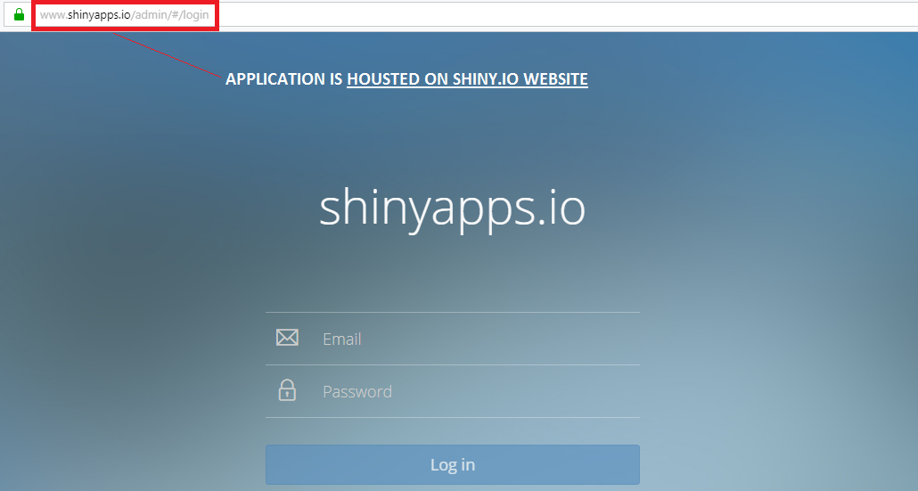
Opportunities: Application Log in
Easiest solution to implement is based on Microsoft’s ShinyApps.
The application can be parked on a ohridskabanka.shinyapps.io or ohridskabanka.mk/application domain, while application itself can be hosted on the cloud or on-premise server. Applications can also be made for client usage and embedded at any page in the website with a simple <iframe> tag.
Various security measures can be implemented, depending on the security requirements, ranging from simple username and passwords to multi-factor authentication. Access through firewall, encryption of data
are additional options too.

Slide 10
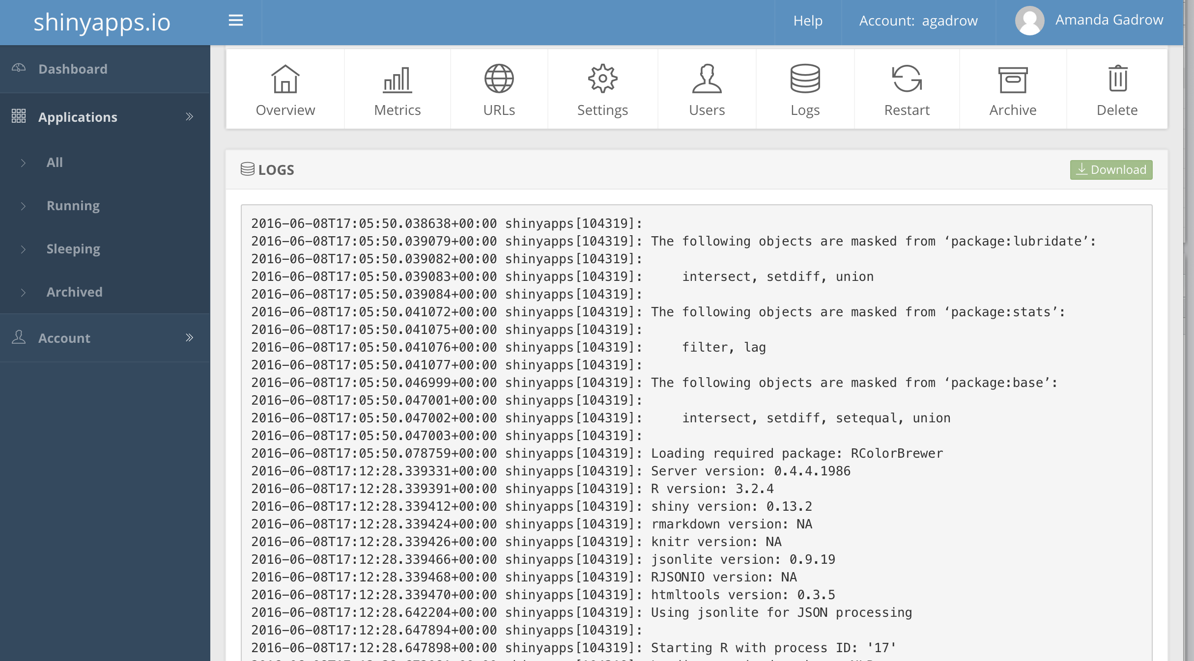
Opportunities: Application management
The technology enables pro-active management of the application with some of the following options:
Hosting multiple apps at multiple domains;
User management;
Logs of user activity;
Analytics of application usage.

Slide 11
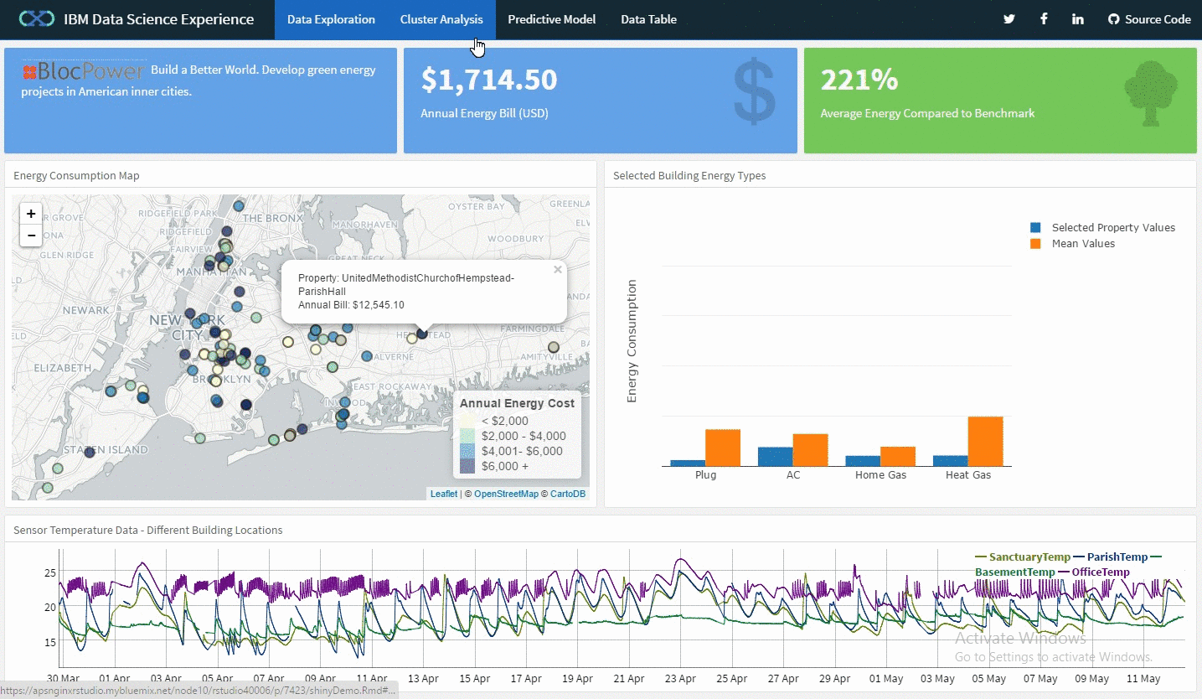
Application: Example

Slide 12
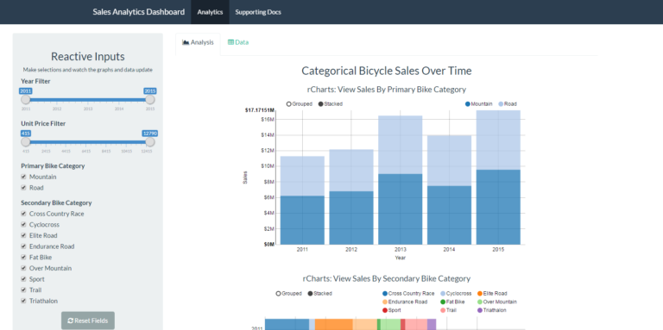
Example Application (1/2)
Application purpose: Sales analytics
Link: https://mdancho84.shinyapps.io/shiny-app/
User input in pane changes the view of analytics and data

Slide 13
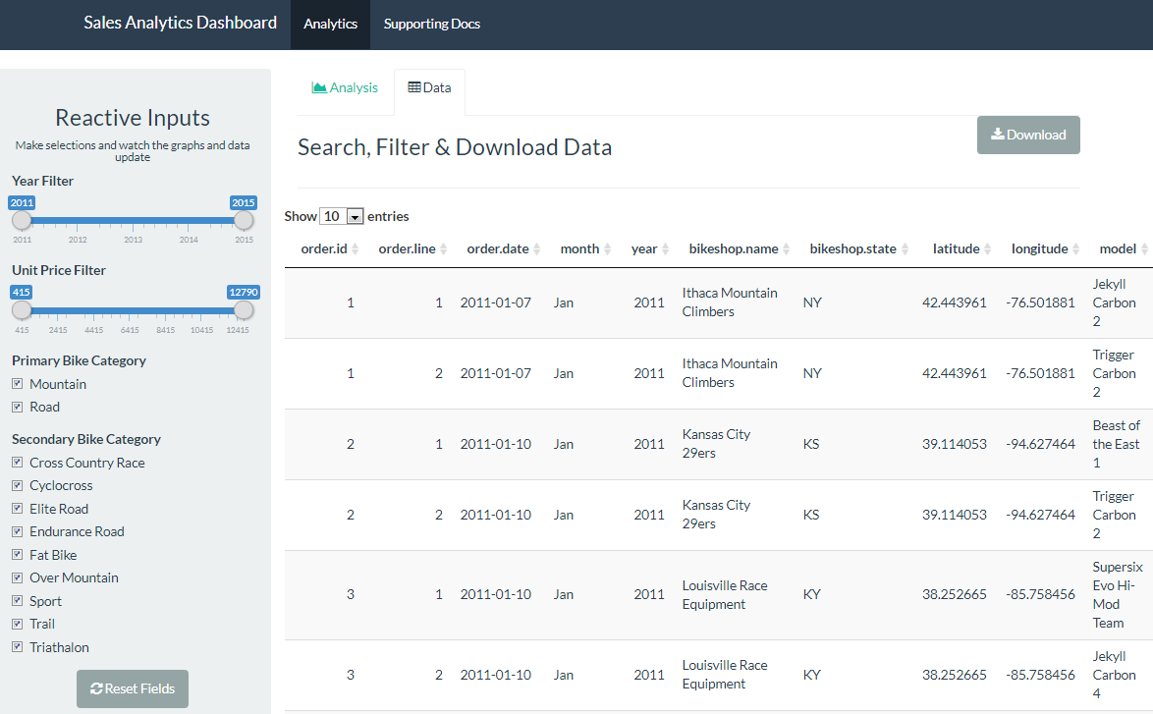
Example Application (1/2)
Application purpose: Sales analytics
Link: https://mdancho84.shinyapps.io/shiny-app/
Download
select data
User input in pane changes the view of analytics and data

Slide 14
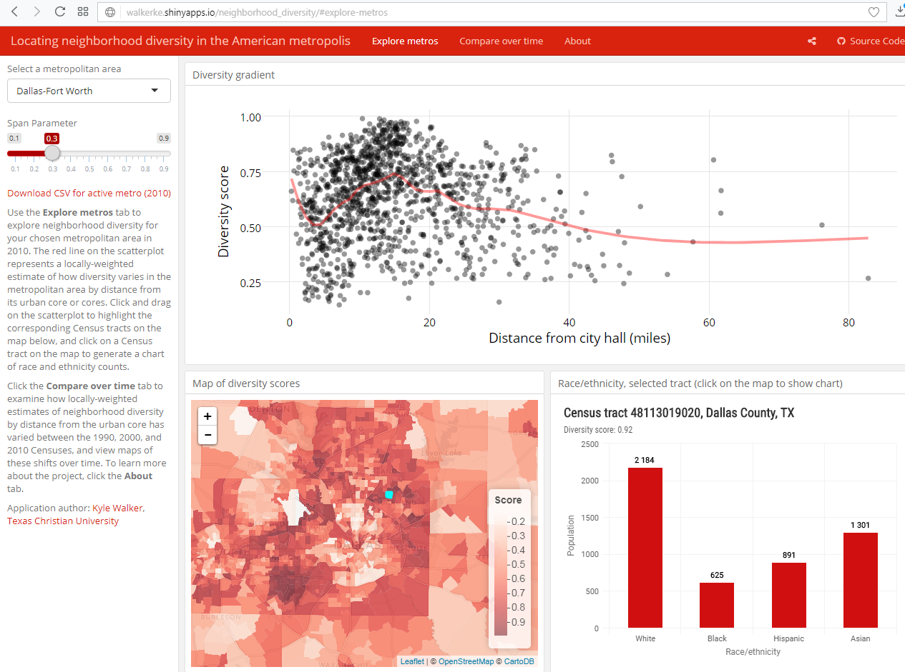
Example Application (2/2)
Application purpose: Geo-spatial analytics
Link: https://walkerke.shinyapps.io/neighborhood_diversity/#explore-metros

Slide 15
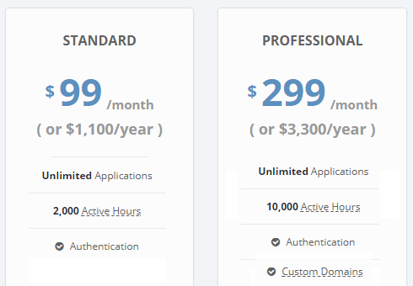
Pricing
Cloud solutions
Internal
Shiny Server
Security benefits:
Application and Data is hosted on internal
OBSG server
Custom tailored security measures: access
behind firewall, limitation to handful of IP
Addresses, token or other type of authentication
Computational benefits:
Unlimited number of active hours
Side effects:
Cost of $833 /month or $9,995 a year
Complexity in setting up the server and server
maintainment
Both solutions:
Data can be located on internal database or on the cloud (Amazon Web Services, Microsoft Azure, Rstudio)
Application is hosted on the cloud
Differences:
Professional solution offers possibility to host application on custom domain: ohridskabanka.mk/dashboard, this also enables additional security options such as token
authentication.

Slide 16
Further details
Documentation:
Open Source solution - shiny.io link:
Options and pricing: http://www.shinyapps.io/
Tech specification: http://docs.rstudio.com/shinyapps.io/
Onsite Server - shiny server link:
Options and pricing: https://www.rstudio.com/pricing/
Tech specification: https://www.rstudio.com/products/shiny-server-pro/
2. Free applications examples:
Link: https://www.showmeshiny.com/

